Slide 1
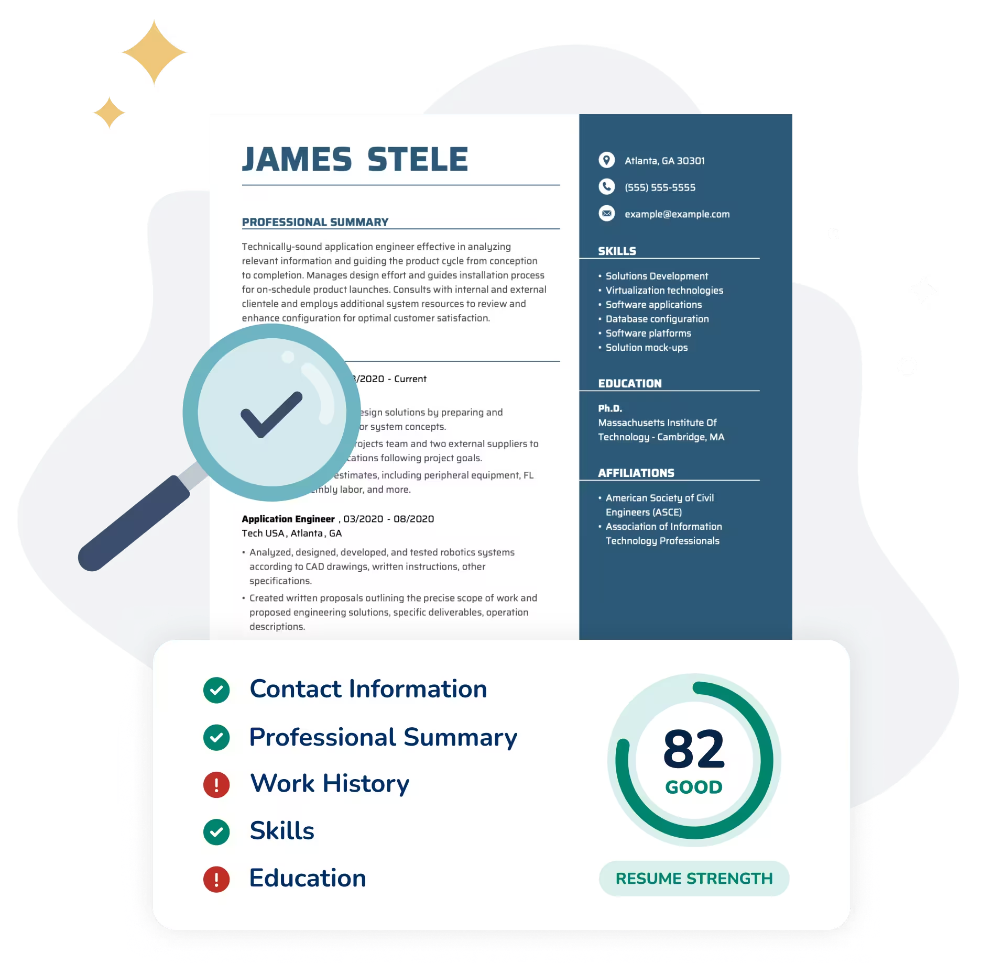
CSE 5717 – ATS Feedback
System
Team 1: Loc Tran, Andrew Graham, Kunal Bagga

Slide 2

Problem Statement:
The Applicant Tracking System (ATS) is a frequently used system that hiring managers used to filter applicants. The system reads the text and asserts how well the applicant fits the job description by giving a 0 if the applicant will not get an interview and a 1 if the applicant will get an interview. Our goal is to give feedback on how well a resume fits with the job description, like how well the skills align.

Slide 3
Resume Dataset:
Job Description Dataset:
This dataset was aggregated from 3 other datasets. These other datasets were compiled of resumes from livecareer.com, a github repo, and other resumes scraped from the internet. This dataset provides columns such as:
person_id,
title,
experience,
and skills.
This dataset was created through the Python Faker library and was refined using ChatGPT, meaning that this dataset is all synthetic data. This dataset provides columns such as:
job_id,
experience,
qualification,
job title,
skills,
and responsibilities.

Slide 4

Data Preparation:
Dataset Downsizing
Both resume and job description datasets were initially downsized to the first 10,000 rows to manage computational resources and focus our analysis.
Resume Unification
Multiple resume csvs were merged into a single, cohesive dataset, ensuring consistency and ease of processing for subsequent steps.
Domain Filtering
To maintain relevance, both datasets were rigorously filtered to include only CS and tech-related entries, aligning with the project's scope.
Final Data Shapes
Post-preparation, the datasets achieved their final dimensions: Resumes (7856 × 5 rows/columns) and Job Descriptions (3217 × 6 rows/columns).

Slide 5
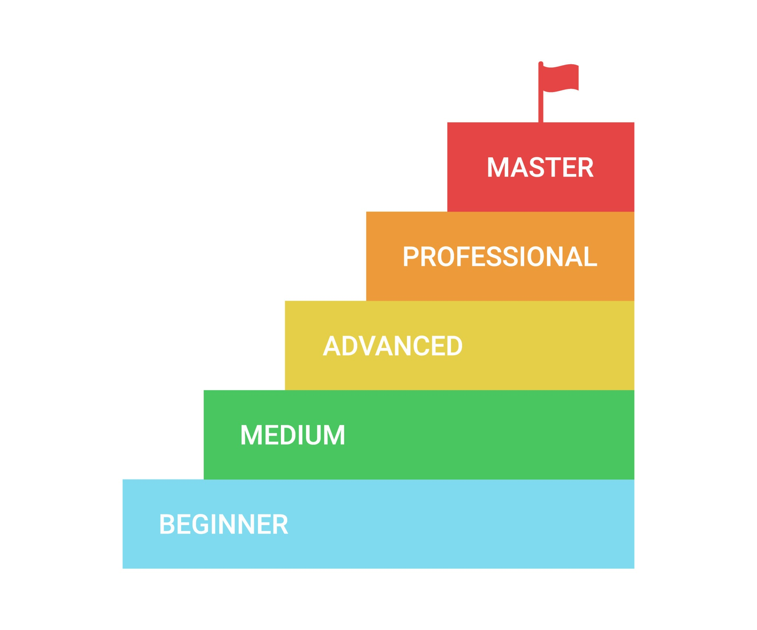
Embedding-Based Filtering: Identifying Relevance
To accurately assess the relevance of resumes and job descriptions, we used advanced natural language processing techniques.
Sentence Transformers were used to generate high-dimensional text embeddings, filtering semantic text using reference vectors were crafted from CS job titles and a list of CS-related keywords.
Cosine similarity was then computed between document embeddings and reference vectors to quantify relevance.
A 37.5% similarity threshold was applied to precisely select only highly tech-relevant entries for further analysis.

Slide 6

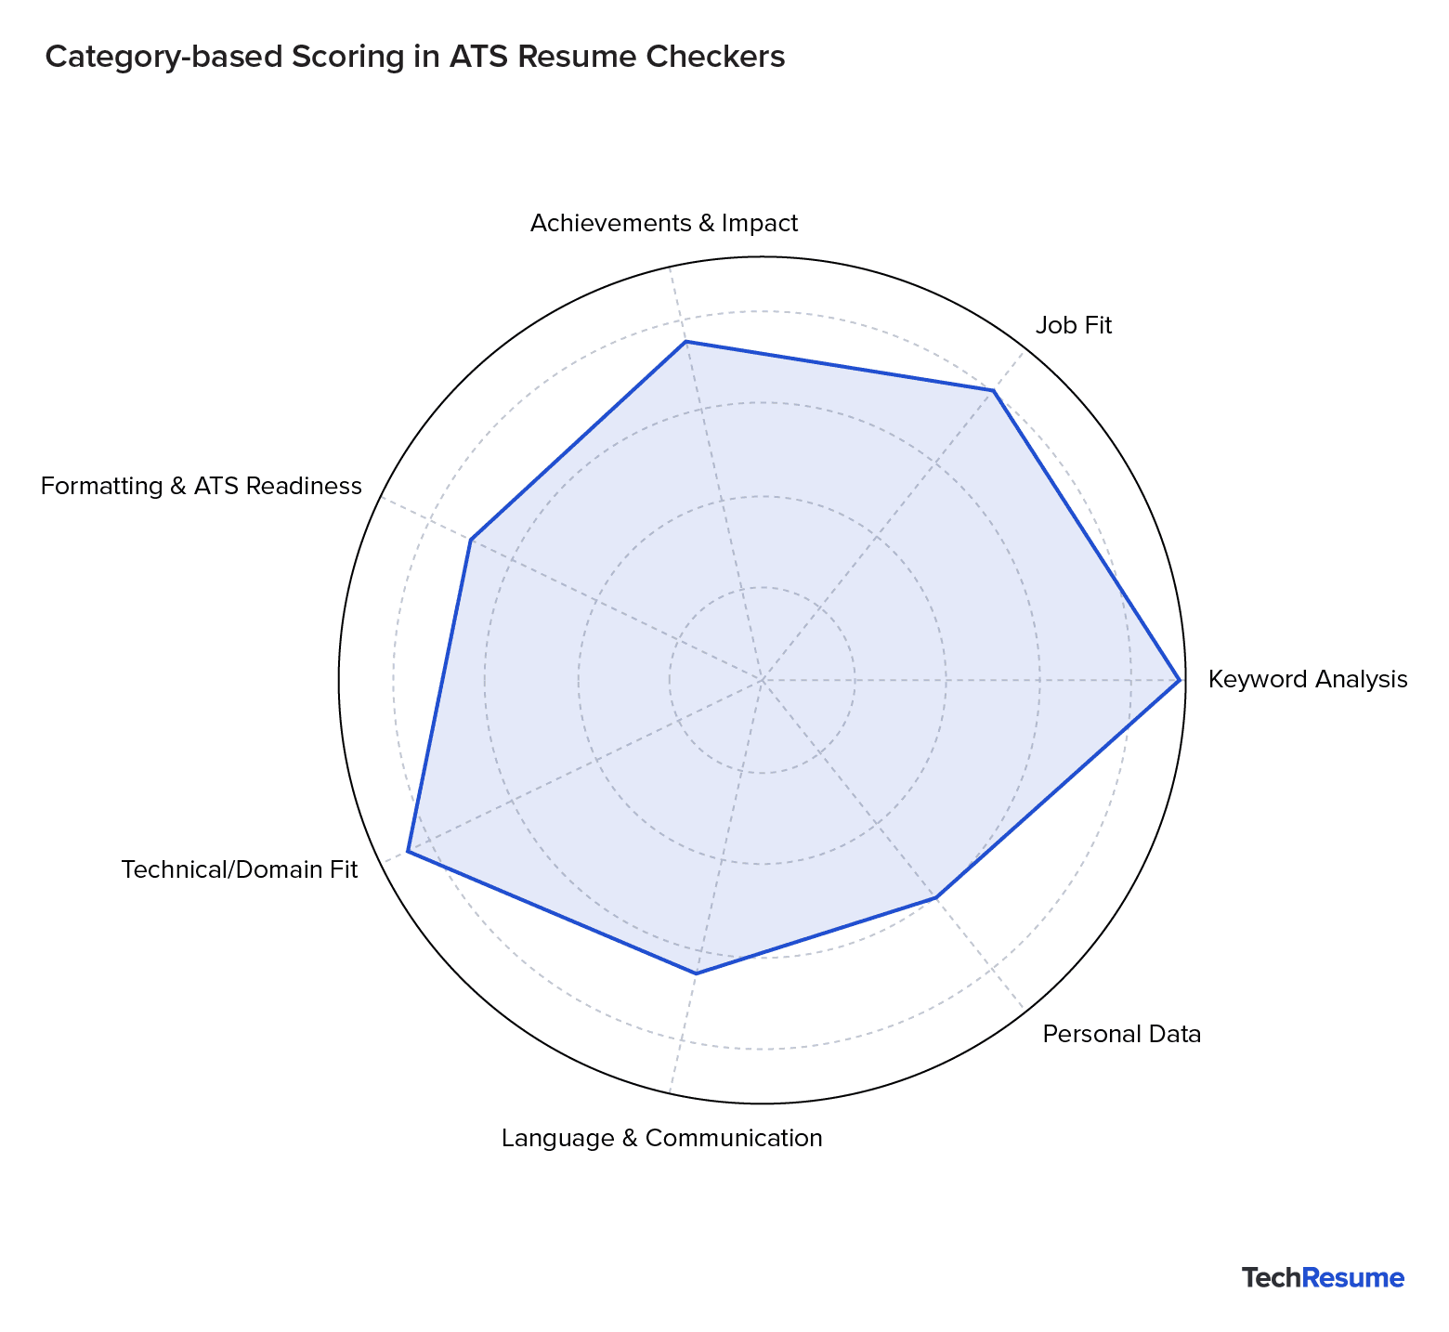
Generating Binary Interview Labels with Gemini
Simplified Prompt:
Compare Resume with Job Description. Does applicant get interview (1/0)?
To train our initial classification model, we generated binary interview labels using an LLM like Gemini.
We utilized the Gemini 2.5 Flash Lite model for its efficiency and accuracy in contextual understanding.
The model's prompt was designed to return a binary outcome: 1 if the applicant "gets an interview," and 0 if they "do not get an interview."
A subset of top 25 resumes and top 50 job descriptions was selected, resulting in 1250 unique resume-job pairs for labeling.

Slide 7
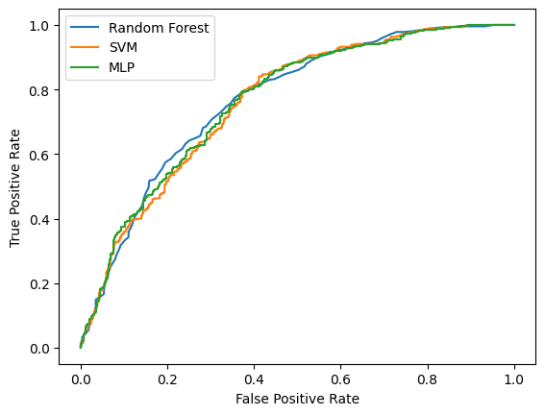
Binary Interview Classification Model
Our initial step into predictive modeling involved a binary classifier to determine interview suitability.
The chosen model for this task was a Random Forest, known for its robustness and ability to handle complex feature interactions.
Feature vectors were derived directly from the embeddings at the specified resume_id and job_id indices, ensuring semantic richness.
To reduce dimensionality and mitigate potential overfitting, Principal Component Analysis (PCA) was applied, effectively compressing 384 dimensions down to 2.
A standard train/test split was performed to rigorously evaluate the model's performance and generalization capabilities.

Slide 8
Multiclass Subjective Labeling: Granular Feedback
Moving beyond binary, we explored a more nuanced feedback system through multiclass labeling.
Gemini Model Consistency
Three Classification Tiers
The same efficient Gemini 2.5 Flash Lite model was employed, ensuring consistency in AI-driven labeling.
We defined three distinct subjective classes:
0 = Not Related: Skills show minimal to no alignment.
1 = Moderately Related: Some overlap, but not a strong match.
2 = Closely Related: Strong alignment of skills and requirements.
Targeted Skill Comparison
Structured Prompt Design
The labeling focused on comparing the first 300 resume skills against the first 300 job skills for each pair.
A carefully crafted structured prompt guided the Gemini model in its skill comparison, ensuring precise contextual understanding and consistent output.

Slide 9

Multiclass Feedback Classification Models
Model Approach
1
Built classifiers to predict 0 / 1 / 2 relevance scores (Not Related, Moderately Related, Closely Related) using the Gemini-generated multiclass labels.
Feature Representation
2
Used embedding vectors from Sentence Transformers to represent both resumes and job descriptions, ensuring the model captured semantic similarity between skill sets.
Training/Evaluation Strategy
3
Trained standard multiclass models (e.g., Random Forest, MLP) and evaluated them with accuracy and confusion matrices to understand where the model confused similar classes.
Visuals/Results
4
Planned visual outputs such as class distribution, confusion matrix, and per-class accuracy to show how well the model distinguishes between the three relevance levels.

Slide 10








Error Analysis, Future Improvements, and Conclusion
Error Analysis
Model Improvements
Accuracy peaked at ~70%, mainly because the early labels (400-label set) introduced bias and noise thathurt model performance.
Adding more labels (1250) helped the MLP, but RFC/SVM dropped slightly, showing sensitivity to inconsistent or low-quality labels.
Improve label quality by using a stronger LLM or better APIs, and randomly sample data to avoid skewing toward specific job types.
Increase dataset size further and refine embeddings to reduce bias, avoid overfitting, and raise overall accuracy.
Final Summary
Future Work
Our pipeline successfully automated ATS-style feedback, with the MLP performing best, but both binary and subjective feedback models showed clear limitations tied to label quality.
•The project proved the approach works, but higher-quality labels and stronger embedding methods are needed for reliable real-world accuracy.
Expand labeling with higher-accuracy LLMs and larger sampled datasets for more reliable predictions.
Integrate real-time resume feedback, stronger text embeddings, and improved subjective scoring for a more complete ATS-style evaluation tool.

